Slide 1
Predictive Modeling for Heart Attack Risk using Health Data
FCS2 Group 4
Chua Ze Ming
Nick Lee Zhi Xiang
Agrawal Madhav

Slide 2
Overview
01
04
02
05
03
06
Practical Motivation
Machine Learning
Background
Models used & reasons, fine tuning
Problem formulation
Results
Defining our problem
Discussion
Statistical Description
Conclusion
Data preparation & cleaning, EDA

Slide 3
01.
Practical Motivation

Slide 4
Practical motivation
Annually (USA)
800,000 suffer heart attacks
600,000 are First Timers
Benefits of early risk detection
Early intervention
Reduce healthcare cost
Improved prognosis

Slide 5
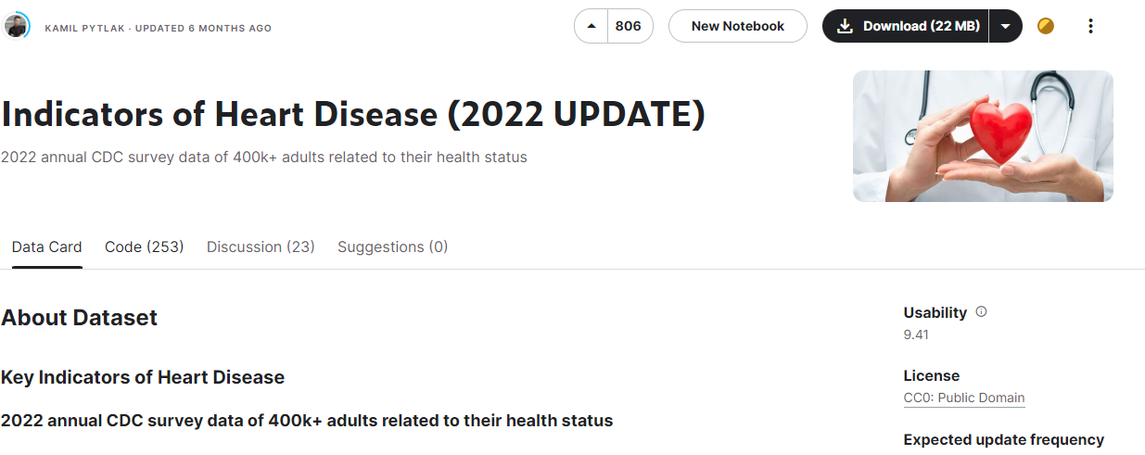
Dataset
https://www.kaggle.com/datasets/kamilpytlak/personal-key-indicators-of-heart-disease

Slide 6
Problem formulation
02.

Slide 7
Problem statement
With the alarming number of people suffering from heart attacks annually, there comes a need for predictive risk assessment as it would benefit the individuals

Slide 8
General idea
Adult's Health Report
Age | 30-40
BMI | 23
⠇ | ⠇
Had Diabetes | Yes
Former Smoker | Yes
Model
Risk

Slide 9
Statistical Description
03.
Data preparation & cleaning, EDA

Slide 10
Dataset
Total rows | 246022
Total columns | 41
Number of Numerical Data | 7
Number of Categorical Data | 34
Dataset provides us with an abundance of information
Quite a few don't seem very relevant
Arthritis, Deafness, Blindness
Many features are numerical, but encoded as a categorical range

Slide 11
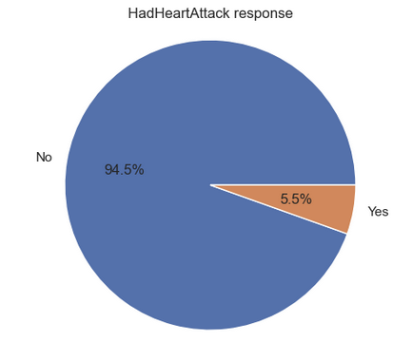
HadHeartAttack
Response variable
Huge class imbalance
Will have to do some form of sampling
Even out the imbalance
Total: 246022

Slide 12
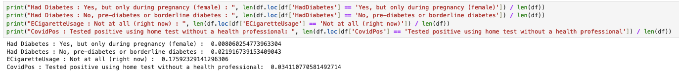
Data cleaning
Certain features had categorical data that are of an extremely specific case
We analyzed these these features and noted that some are an insignificant part of the dataset
Significant, don't cast
Insignificant, cast

Slide 13
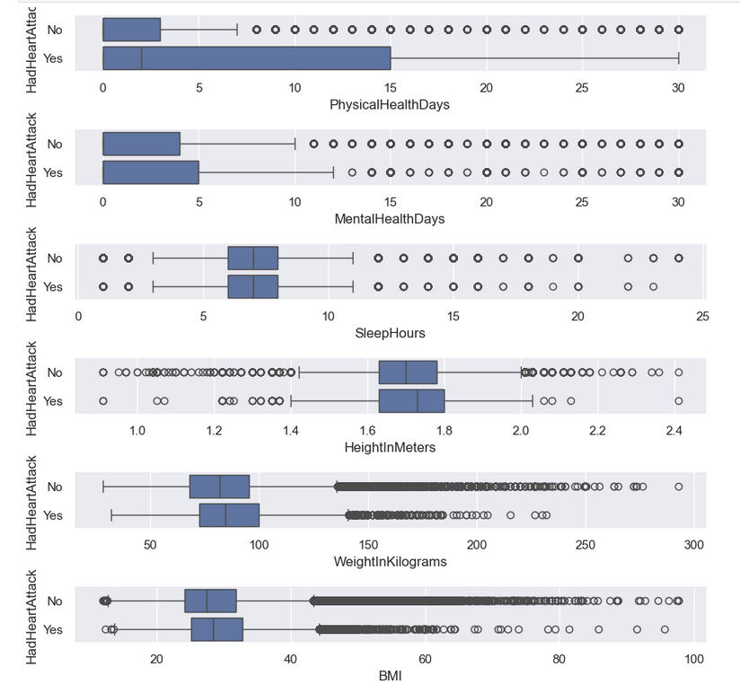
Numerical EDA
6 numerical features
Boxplot
Helps show partition between numerical and categorical variables
Observation:
PhysicalHealthDays seem to be important

Slide 14
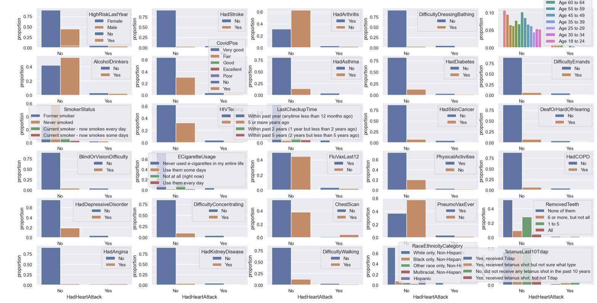
Categorical EDA
Count plot
Too many features
Very cluttered and hard to tell
The class imbalance is prominent
Hard to see the proportional difference
Undersample

Slide 15
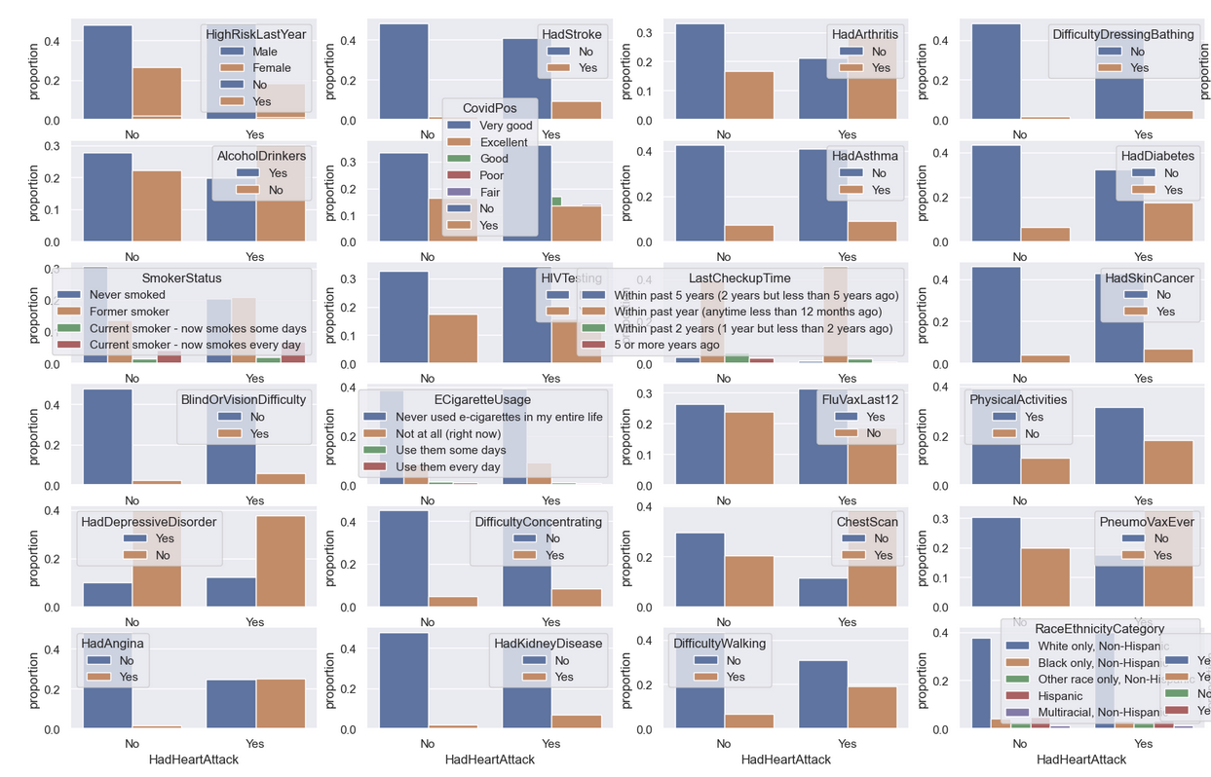
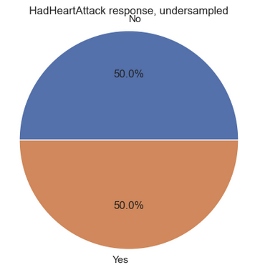
Categorical EDA (Undersampling)
Easier to spot relation
Change in proportion between classes indicates possible relationship
HadAngina, ChestScan, HadArthritis stands out

Slide 16
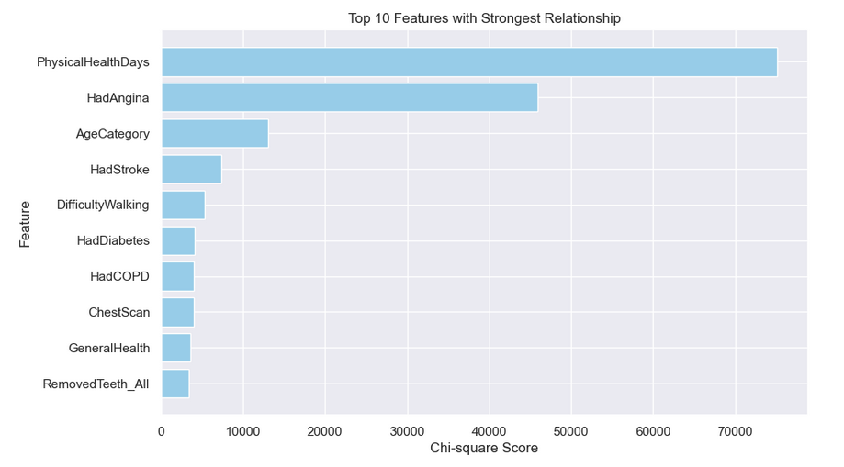
Feature Selection
Confirm our findings concretely
Chi-square
Find features with strong relationship
Good for categorical predictors and response
Towards the end of the graph, we see the significance of features start to drop off

Slide 17
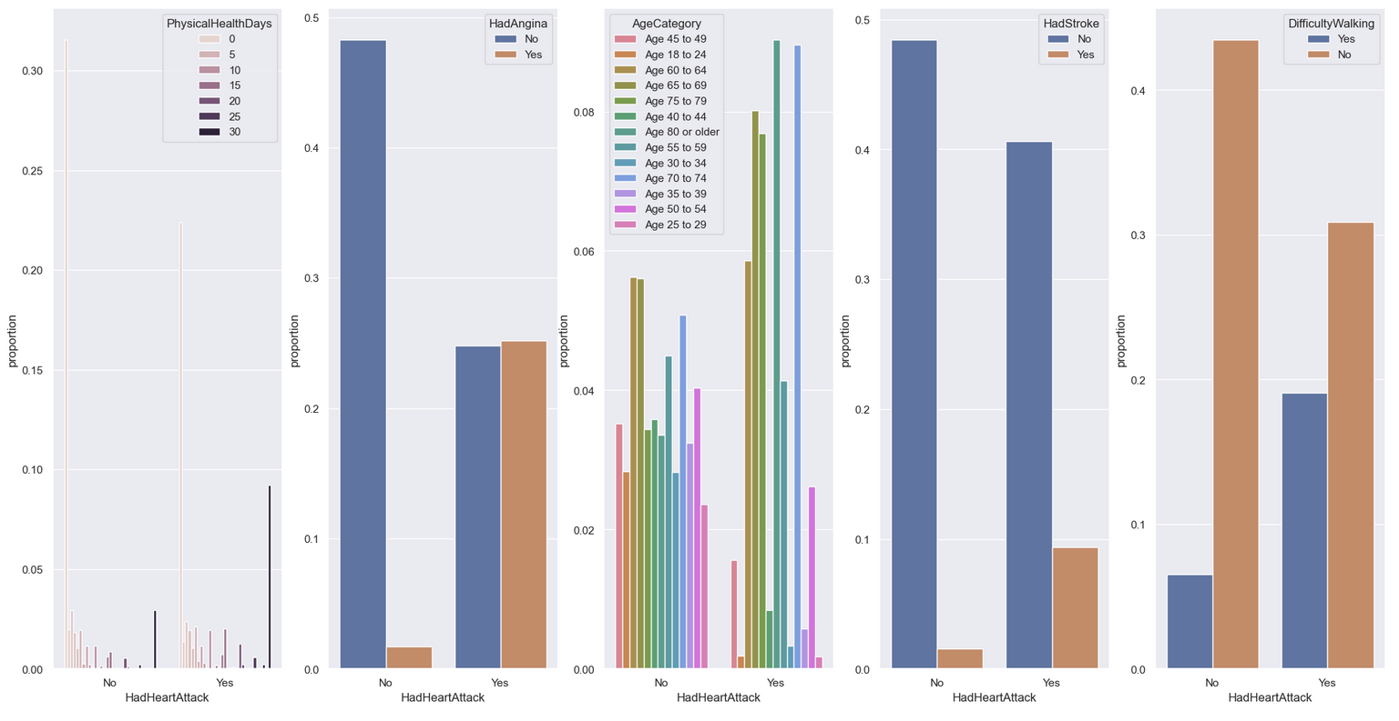
Top 5 Features
We selected the top 5 features
In depth look to confirm selection

Slide 18
04.
Machine Learning

Slide 19
Classification Problem
As this is a classification problem, we shortlisted a few models that we feel would suit this problem
 | Handles numerical & categorical data | Robust to outliers | Robust to irrelevant data | Comments
Decision Tree | ✔ | ✔ |  | Shows Feature importance
Random Forest | ✔ | ✔ |  | Handles high dimensional data Reduces overfitting
Logistic Regression | ✔ |  | ✔ | Shows linear relation if any

Slide 20
Evaluation metrics
Overall accuracy
Recall
Cross validation
Confusion matrix
Mean squared error
F1 score
Medical problem
True positive
True positive + False Negative
Reduce variance
Detects overfitting
Fair comparison against other models

Slide 21
05.
Results

Slide 22
Initial Results (Undersampled)
 | Accuracy (Train) | Accuracy (Test) | Recall (Test) | Evaluation | Comments
Decision Tree | 77% | 86% | 66% | 86%
Random Forest | 79% | 84% | 68% | 84%
Logistic Regression | 78% | 85% | 68% | 85%

Slide 23
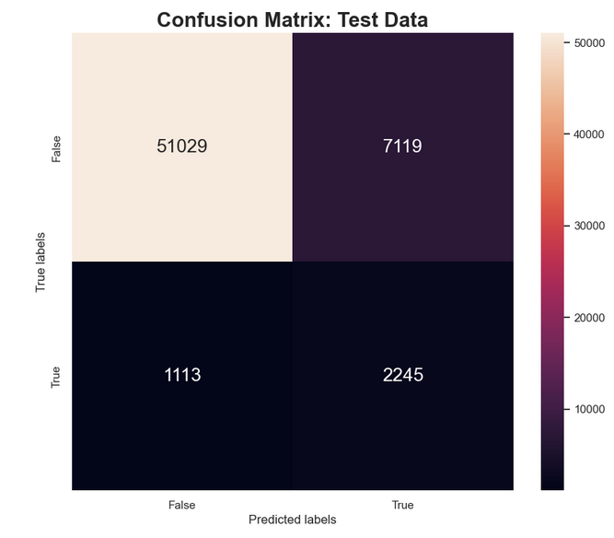
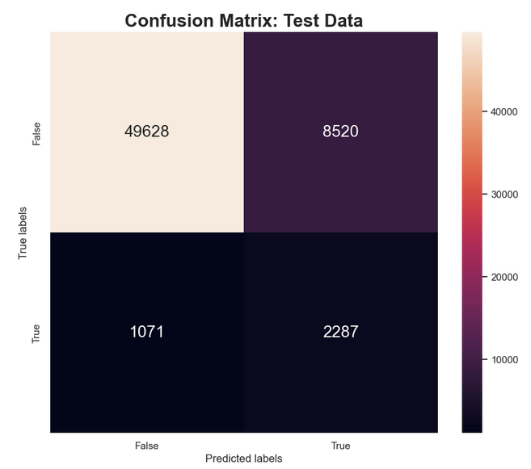
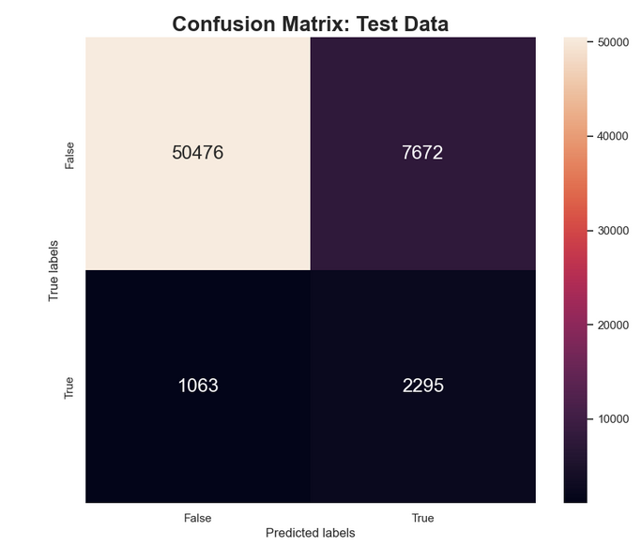
Initial Results (undersampled)
Confusion matrix (Test)
Decision Tree
RandomForest
Logistic Regression

Slide 24
Possible Hypothesis
Solution : Over+Under Sample
Perhaps one reason our model was not training very well was because we lost too many features while under sampling
This can be expected as we essentially threw away 200k data points
To tackle this problem, we used SMOTEENN sampling
aka Synthetic Minority Over-sampling Technique (SMOTE) + Edited Nearest Neighbors (ENN)
generates synthetic samples for the minority class (SMOTE)
removes noisy samples (ENN)

Slide 25
Resampling
Dataset
75% Train set
25% Test set
Resampler
Training set
Train the model
Evaluate model

Slide 26
Intermediate Results (Resampled)
 | Accuracy (Train) | Accuracy (Test) | Recall (Test) | Evaluation | Comments
Decision Tree | 94% | 93% | 46% | 93%
Random Forest | 97% | 90% | 44% | 90% | Overfitted
Logistic Regression | 94% | 93% | 54% | 93%

Slide 27
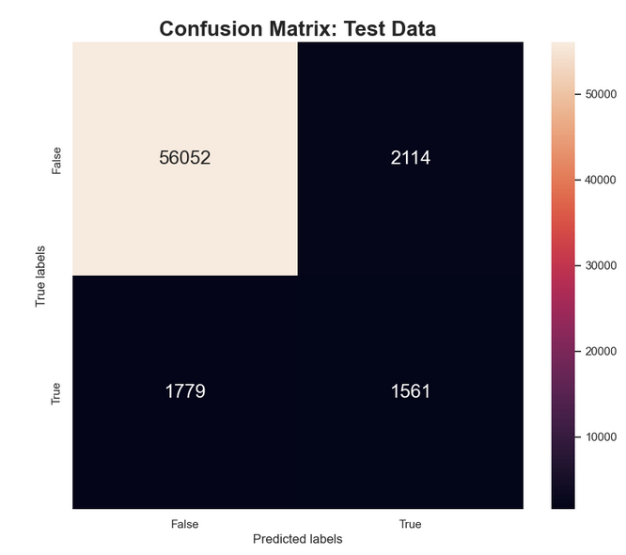
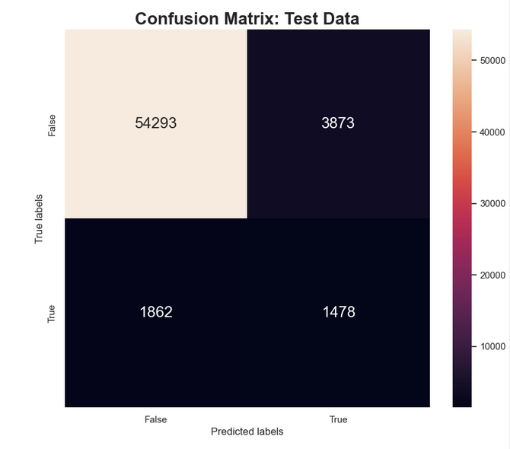
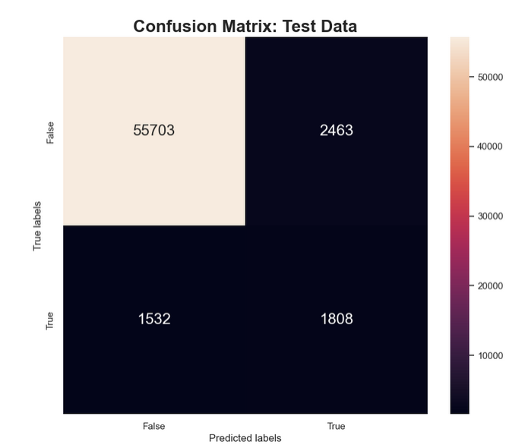
Intermediate Results (Resampled)
Confusion matrix (Test)
Decision Tree
RandomForest
Logistic Regression

Slide 28
Discussion
LogisticRegression performed the best with resampled data
Accuracy: 94%
Recall: 54%
Evaluation: 93%
Preserved more information with SMOTEENN resampling
Variance caused by class imbalance (only say if we are doing no sampled data)

Slide 29
Hyperparameter Tuning
Randomized Search
Try to improve any our model further
Randomized Search used to tune hyperparameters
Optimization technique used to find the best hyperparameters for a machine learning model
Randomly selects combinations of hyperparameters from predefined ranges

Slide 30
Final Results
Hyperparameter tuning did not yield any noticable results
 | Accuracy (Train) | Accuracy (Test) | Recall (Test) | Evaluation | Comments
Logistic Regression | 94.3% | 93.5% | 54.1% | 93.5%
Logistic Regression (Hyperparameters) | 94.3% | 93.5% | 54.1% | 93.5% | Negligible difference

Slide 31
06.
Conclusion

Slide 32
Did we solve the problem?
We were able to use machine learning to use an individual’s health report to decently predict whether the person will develop a heart attack.
We found that out of the many attributes, only a few make up a significant portion of what helps us with the prediction.
So, going back to our problem, individuals can work on these these attributes to reduce their likelihood of having a heart attack which coincides with mainstream beliefs that the more physically fit a person is, the healthier their cardiovascular health. Thank you

Slide 33
Thanks!
Please keep this slide for attribution

